Slide 1

OOSA&D(2018)
02 Keeping your Objects in the Know：the Observer Pattern

Slide 2
Glossary
pattern ['pæt(ə)n] a model considered worthy of imitation
Dalian Neusoft University of Information © Copyright

Slide 3
Agenda
A Case Analysis
Design Pattern: The Observer Pattern
An Application for example
An experiment in class
Practices of design pattern as homework
Dalian Neusoft University of Information © Copyright

Slide 4
Agenda
A Case Analysis
Design Pattern: The Observer Pattern
An Application for example
An experiment in class
Practices of design pattern as homework
Dalian Neusoft University of Information © Copyright

Slide 5
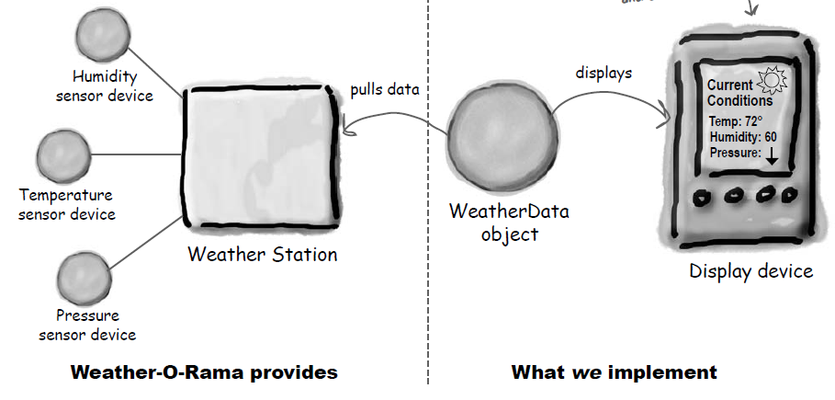
1. A Case Analysis
The Weather Monitoring Application
Dalian Neusoft University of Information © Copyright

Slide 6
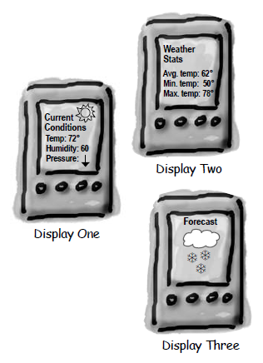
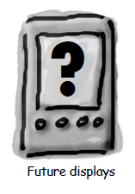
1. A Case Analysis
We need to implement three display elements that use the weather data.
The system must be expandable—other developers can create new custom display elements and users can add or remove as many display elements as they want to the application.
Dalian Neusoft University of Information © Copyright

Slide 7
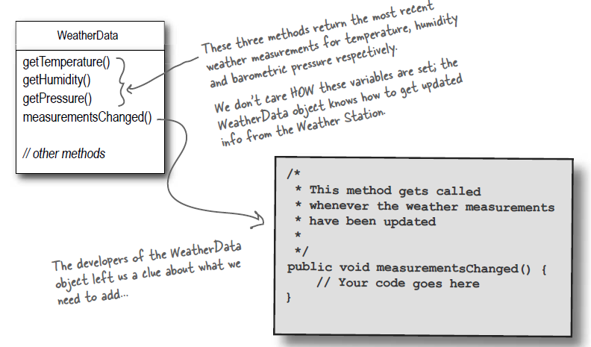
1. A Case Analysis
The WeatherData class
Dalian Neusoft University of Information © Copyright

Slide 8
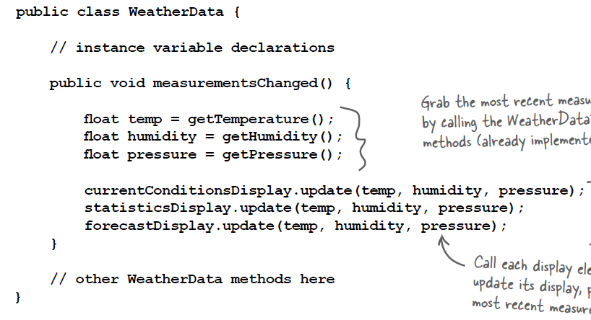
1. A Case Analysis
Here is the first implementation possibility.
Dalian Neusoft University of Information © Copyright

Slide 9
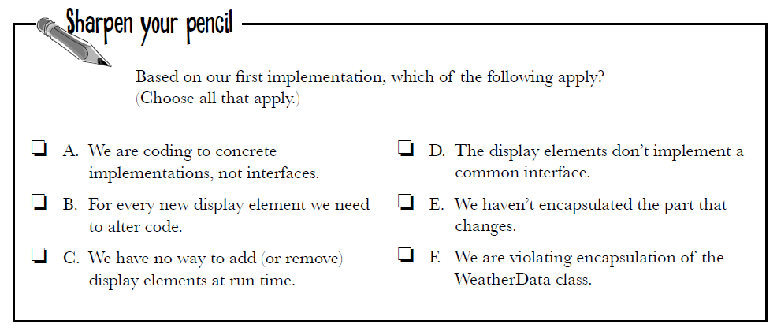
1. A Case Analysis
Here is the first implementation possibility.
Dalian Neusoft University of Information © Copyright

Slide 10
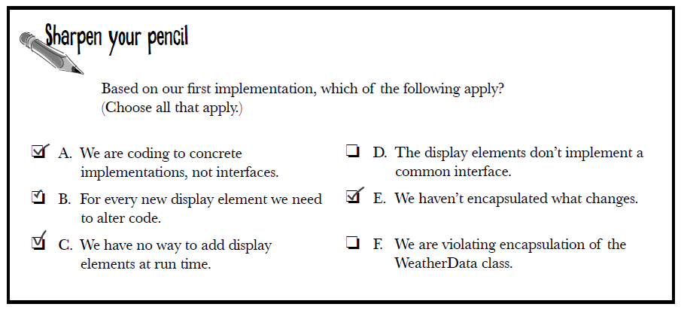
1. A Case Analysis
Here is the first implementation possibility.
Dalian Neusoft University of Information © Copyright

Slide 11
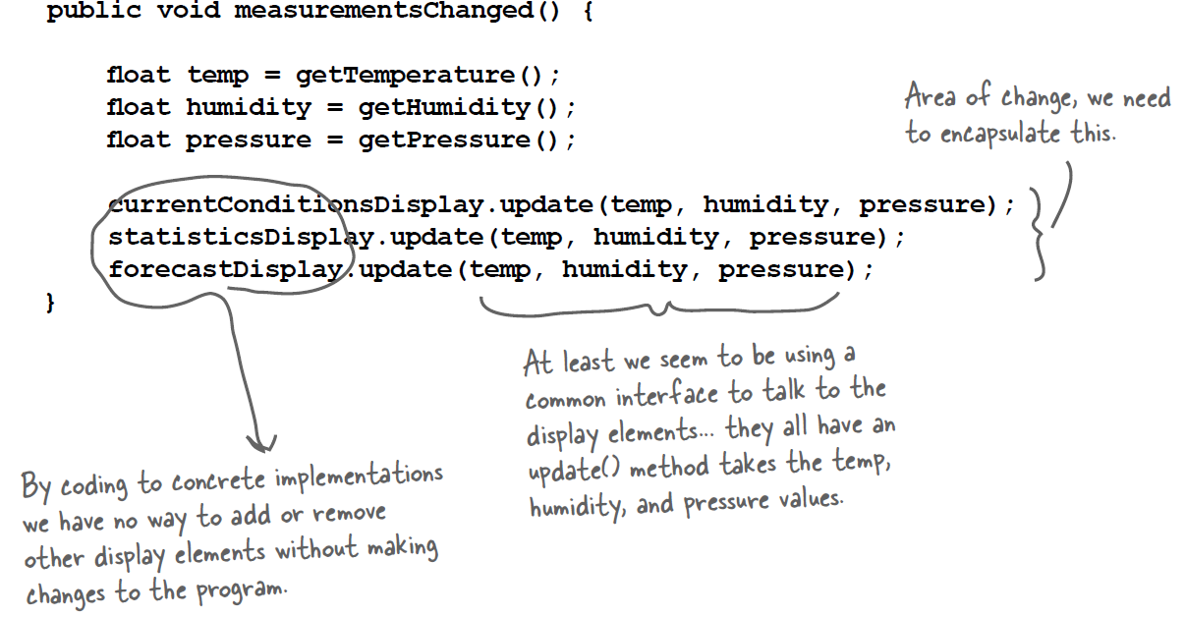
1. A Case Analysis
What’s wrong with the implementation?
Dalian Neusoft University of Information © Copyright

Slide 12
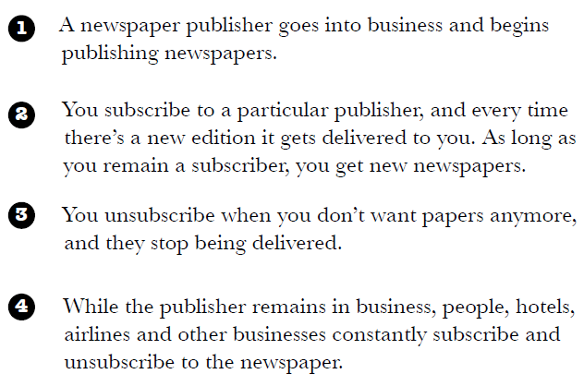
1. A Case Analysis
How newspaper subscriptions work?
Dalian Neusoft University of Information © Copyright

Slide 13
1. A Case Analysis
How newspaper subscriptions work?
报社的任务就是出版报纸；
向某家报社订阅报纸，只要你是他们的客户，你就会一直收到新的报纸。
当你取消订阅了，他们就不会再送新报纸了。
只要报社还在运营，就会有人一直向他们订阅或取消订阅报纸。
Dalian Neusoft University of Information © Copyright

Slide 14
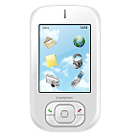

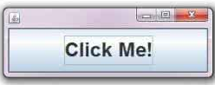

1. A Case Analysis
How newspaper subscriptions work?
to update if you require
WeatherData object
displays
to deliver if you subscribe
publishers
subscribers
to notify if you register
Button object
Listener objects
Dalian Neusoft University of Information © Copyright

Slide 15

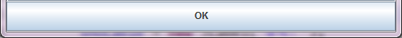
1. A Case Analysis
为按钮注册监听器
创建监听器
监听器：{
执行动作；
}

Slide 16
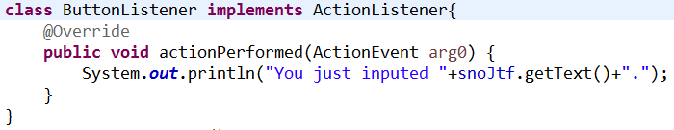
1. A Case Analysis
为按钮注册监听器
创建监听器

Slide 17
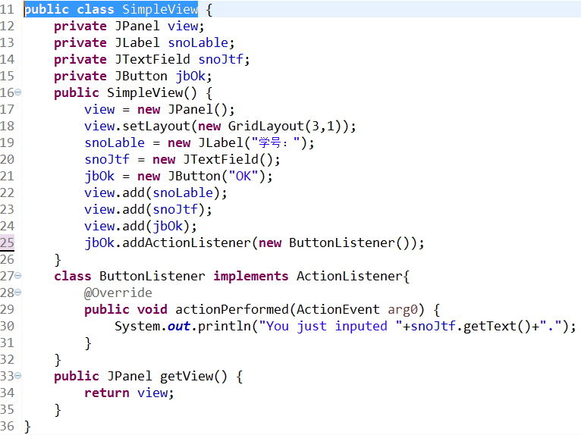
Java GUI程序工作原理
为按钮注册监听器
创建监听器

Slide 18
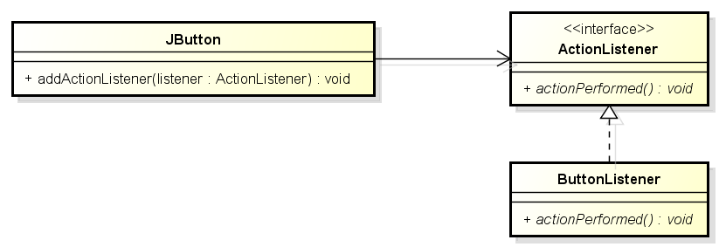
1. A Case Analysis
The Observer Pattern in the JDK
Dalian Neusoft University of Information © Copyright

Slide 19
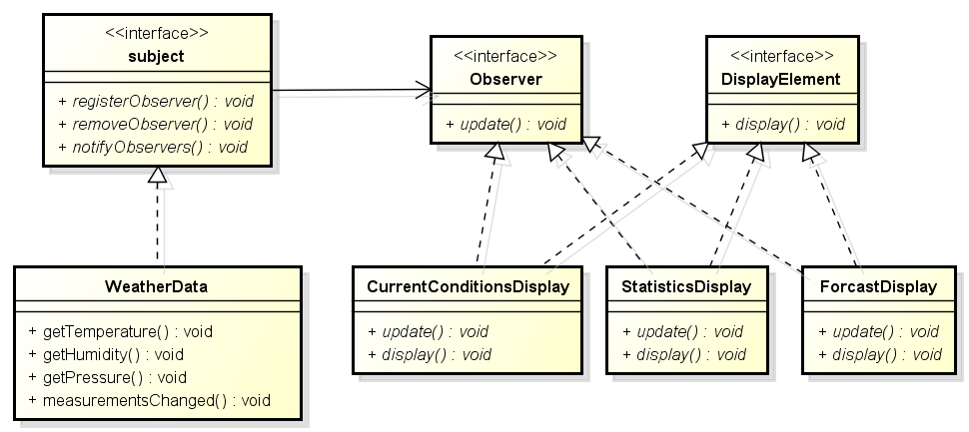
1. A Case Analysis
Designing the weather station
Dalian Neusoft University of Information © Copyright

Slide 20
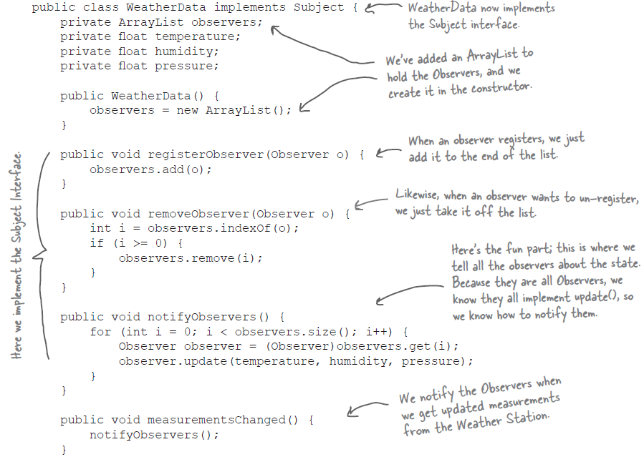
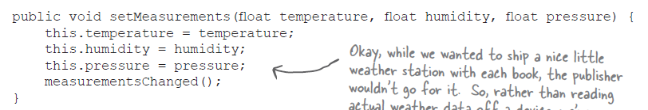

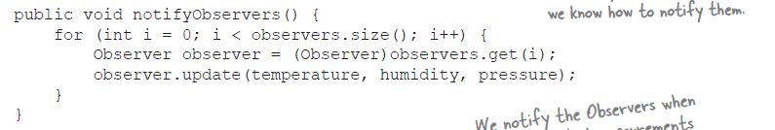
1. A Case Analysis
Designing the weather station
Dalian Neusoft University of Information © Copyright

Slide 21
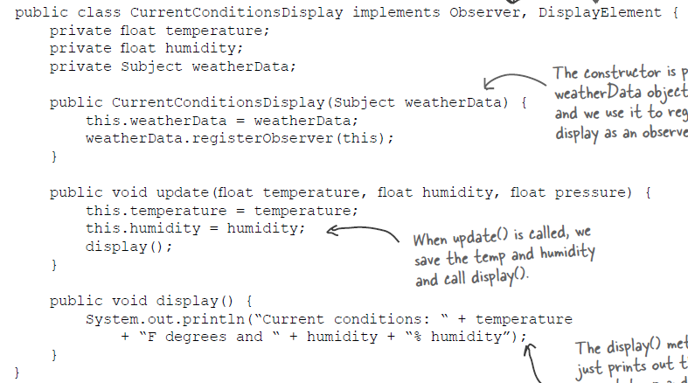
1. A Case Analysis
Designing the weather station
Dalian Neusoft University of Information © Copyright

Slide 22
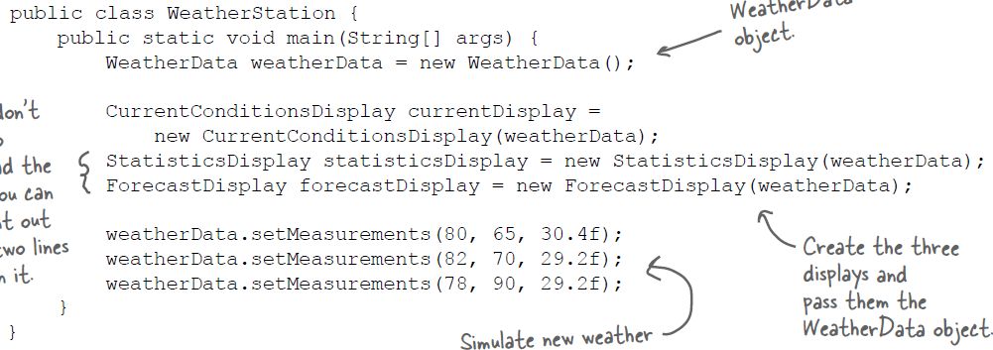
1. A Case Analysis
Testing the weather station
Dalian Neusoft University of Information © Copyright

Slide 23
Agenda
A Case Analysis
Design Pattern: The Observer Pattern
An Application for example
An experiment in class
Practices of design pattern as homework
Dalian Neusoft University of Information © Copyright

Slide 24
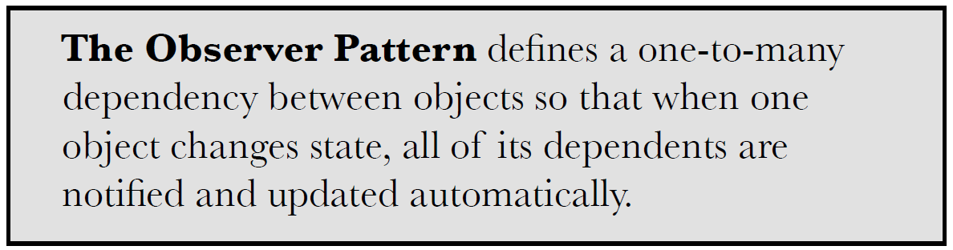

2. Design Pattern
Dalian Neusoft University of Information © Copyright

Slide 25
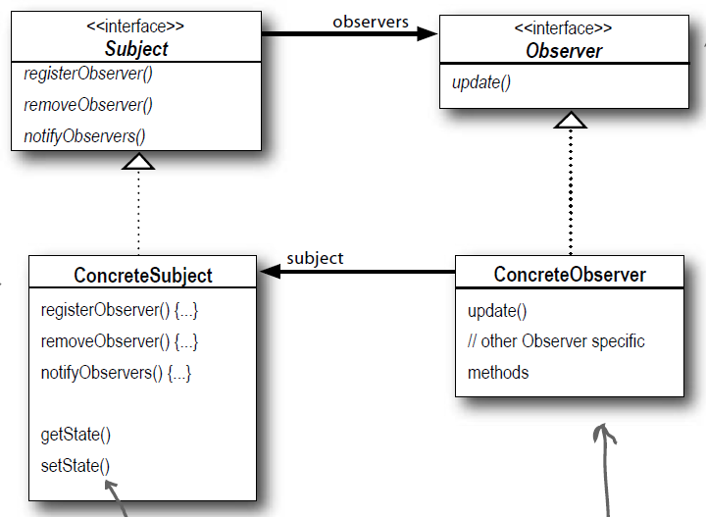
2. Design Pattern
Dalian Neusoft University of Information © Copyright

Slide 26
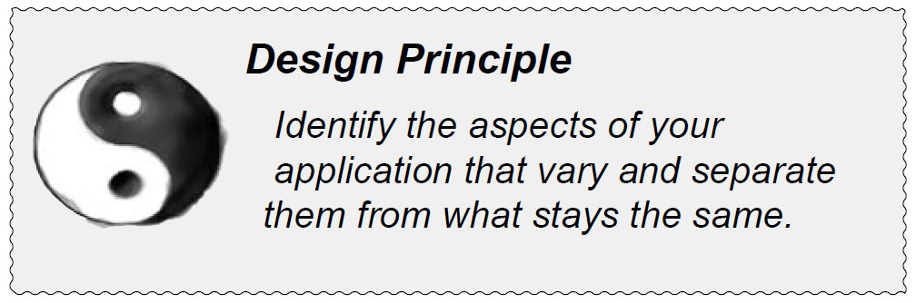
2. Design Pattern
在观察者模式中，会改变的是主题的状态，以及观察者的数量和类型。用这个模式，你可以改变依赖于主题状态的对象，却不必改变主题。这就是提前规划。
Dalian Neusoft University of Information © Copyright

Slide 27
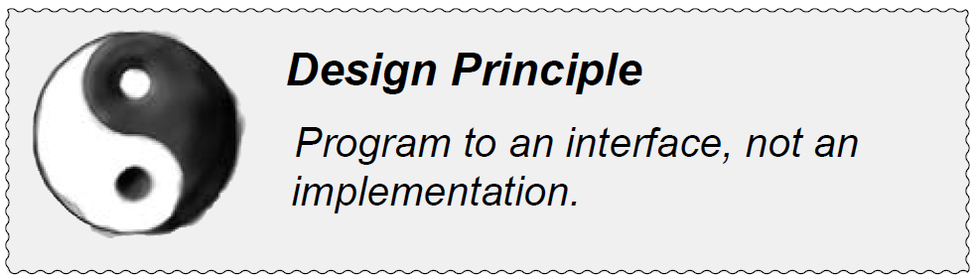
2. Design Pattern
主题与观察者都使用接口，观察者利用主题的接口向主题注册，而主题利用观察者接口通知观察者。这样可以让两者之间运作正常，又同时具有松耦合的优点。
Dalian Neusoft University of Information © Copyright

Slide 28
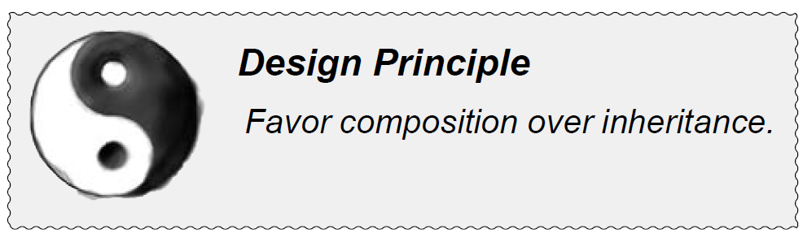
2. Design Pattern
观察者模式利用“组合”将许多观察者组合进主题中。对象之间的这种关系不是通过继承产生的，而是在运行时利用组合的方式产生的。
Dalian Neusoft University of Information © Copyright

Slide 29
Agenda
A Case Analysis
Design Pattern: The Observer Pattern
An Application for example
An experiment in class
Practices of design pattern as homework
Dalian Neusoft University of Information © Copyright

Slide 30
3. An Application for example
A monitoring system : these jewelries can be protected by any beasts as appointment. If the jewelries is touched, these beasts will take action.
Jewelries: Gold, Diamond;
Beast: Lion, Tiger
In future, it is possible to has new jewelry and beast.
Your job is to…
Design the class diagram
program according to your class diagram
Test your design
Dalian Neusoft University of Information © Copyright

Slide 31
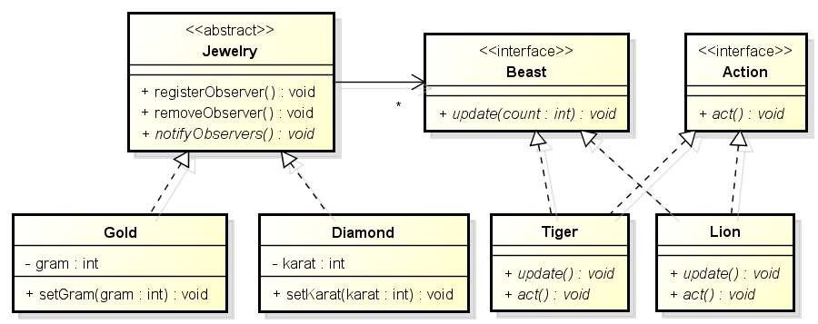
3. An Application for example
A monitoring system
Class Diagram

Slide 32
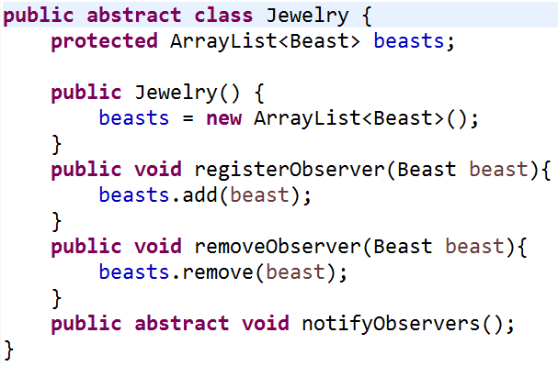
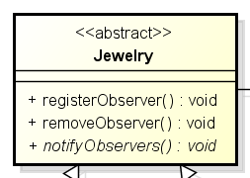
3. An Application for example

Slide 33
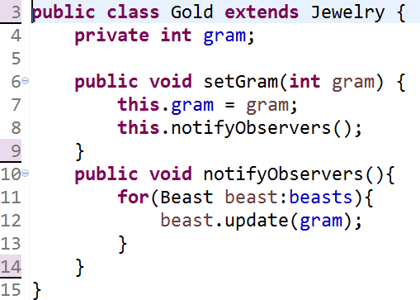
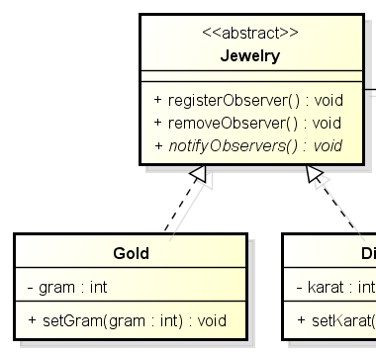
3. An Application for example

Slide 34
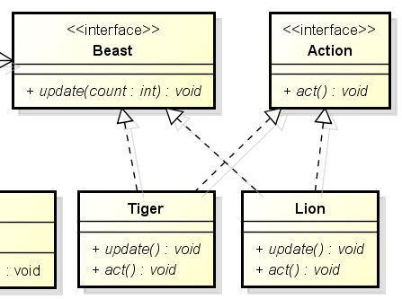
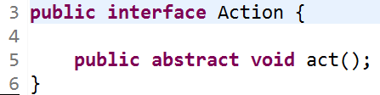
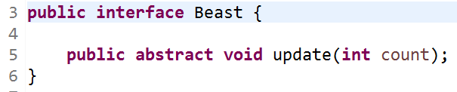
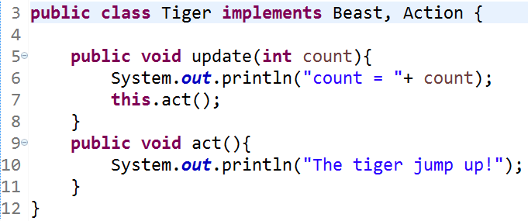
3. An Application for example

Slide 35
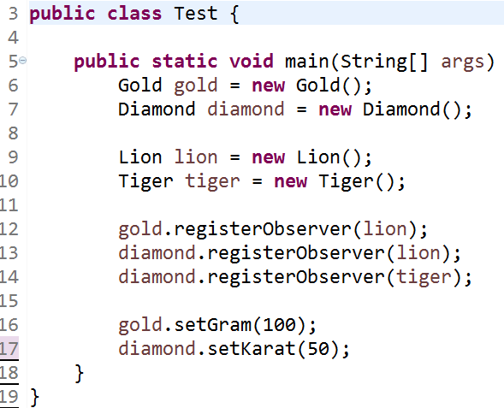
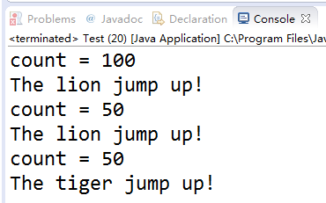
3. An Application for example
Console output:

Slide 36
Agenda
A Case Analysis
Design Pattern: The Observer Pattern
An Application for example
An experiment in class
Practices of design pattern as homework
Dalian Neusoft University of Information © Copyright

Slide 37

4. An experiment in class
An online stock system: When a stock price fluctuates more than 5%, the system automatically notified to all the shareholders.
Your job is to…
Design the class diagram
program according to your class diagram
Test your design with the old price is 100, the new price is 98 and 92.
Dalian Neusoft University of Information © Copyright

Slide 38
Agenda
A Case Analysis
Design Pattern: The Observer Pattern
An Application for example
An experiment in class
Practices of design pattern as homework
Dalian Neusoft University of Information © Copyright

Slide 39
5. Homework
Finish the homework, which includes 3 tasks.
Dalian Neusoft University of Information © Copyright

